Slide 1
Intro to Molecular Dynamics (MD) Simulation using CHARMM
DaVID CHATFIELD, FIU DEPARTMENT OF CHEMISTRY AND BIOCHEMISTRY
Workshop on Macromolecular Modeling
FIU, April 8-9, 2017

Slide 2
Overview
Principles of MD
MD Program Structure
System Preparation
Running MD
Analyzing Results

Slide 3
A. Force Fields
Quantum mechanics (QM): too expensive for macromolecules
Force fields: method of choice
Constructed from experimental data and QM calculations on small molecules
Principle of transferability → atom type

Slide 4
Bonded and Non-bonded Terms
$$V=E_{bonded}+E_{non−bonded}$$

Slide 5
$$E_{bonded}$$
$$E_{bonded}=E_{bond−stretch}+E_{angle−bend}+E_{dihedral} \left(+ …\right)$$
$$E_{bond−stretch}=\sum_{bonds}{K_{b}{\left(b−b_{0}\right)}^{2} }$$
$$E_{angle−bend}=\sum_{angles}{K_{θ}{\left(θ−θ_{0}\right)}^{2}}$$
$$E_{dihedral}=\sum_{dihedrals}{K_{φ}{\left(1+cos⁡\left(nφ−δ\right)\right)}^{2}}$$
A picture is worth a thousand words

Slide 6
$$E_{bonded}$$
Occasionally a few extra terms are included, e.g.
$E_{impropers}$ (to maintain chirality & optimize fit to experiment)
$E_{Urey−Bradley}$ (to optimize ..)
CMAP (numerical correction and optimize ..)
$$E_{impropers}=\sum_{impropers}{K_{ω}{\left(ω−ω_{0}\right)}^{2}}$$
$$E_{Urey−Bradley}=\sum_{Urey−Bradley}{K_{UB}{\left(S−S\right)}^{2}}$$
$$E_{CMAP}=\sum_{residues}{U_{CMAP}\left(φ,ψ\right)}$$

Slide 7
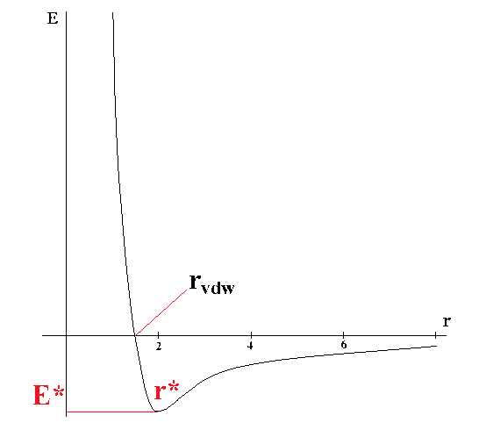
$$E_{non−bonded}$$
$$E_{non−bonded}=E_{van der Waals}+E_{electrostatic}$$
$$E_{vdW=}\sum_{\begin{aligned}non−bonded \\ atom pairs\end{aligned}}{ε_{ij}^{min}\left[{\left(\frac{r_{ij}^{min}}{r_{ij}}\right)}^{12}−2{\left(\frac{r_{ij}^{min}}{r_{ij}}\right)}^{6}\right]}$$
$${ E}_{electrostatic=}\sum_{\begin{aligned}non−bonded \\ atom pairs\end{aligned}}{\frac{q_{i}q_{j}}{4πε_{o}εr_{ij}}}$$
r^{min}
ε^{min}

Slide 8
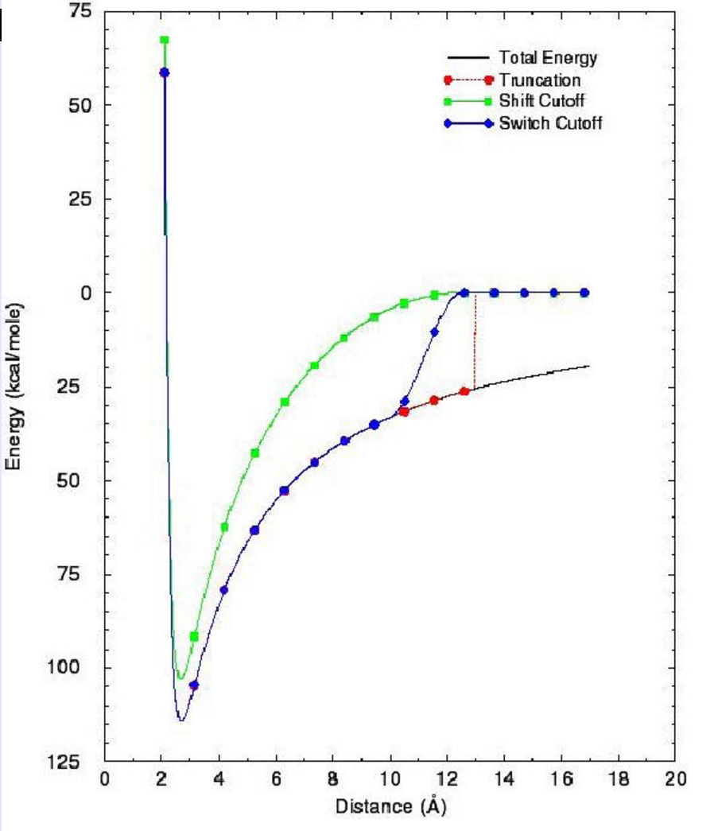
Cut-offs
Reduce computational demands
Makes $E_{non−bond}$ precisely zero beyond pre-defined interatomic distance
Shift method: modifies entire PES (downside: equilibrium distances slightly decreased)
Switch method: modifies PES only over “window” (downside: too small a “window” can introduce strong, non-physical forces)
Van der Waals: always used
Electrostatics: sometimes used

Slide 9
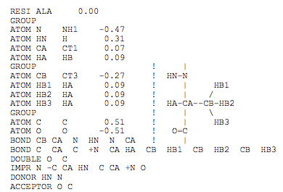
Atom types
Atom name
Atoms classified by TYPE
E.g. sp² and sp³ carbons: different TYPES
Parameters defined by TYPE
Compromise between:
Different properties for every conceivable environment (impractical)
Only one property set per element only (too inflexibe)
Atom type
Topology file entry
Carbon atom types (Parm22)
Parameter file entry
HA CT3 322.000 1.1110
K_{b} (kcal/mol-Å²)
r_{e} (Å)

Slide 10
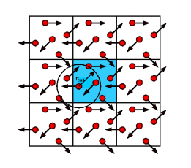
B. Solvation Method 1: Periodic Boundary Conditions
Central box surrounded by neighbors
Only particles in central box modeled explicitly
Particles in surrounding boxes are images
Forces on primary particles include interactions with images
Several lattices available: cubic, truncated octahedral, …
$E_{electrostatics}$ can be calculated without cut-offs using clever series expansion: EWALD method
Cut-offs needed for $E_{VDW}$

Slide 11
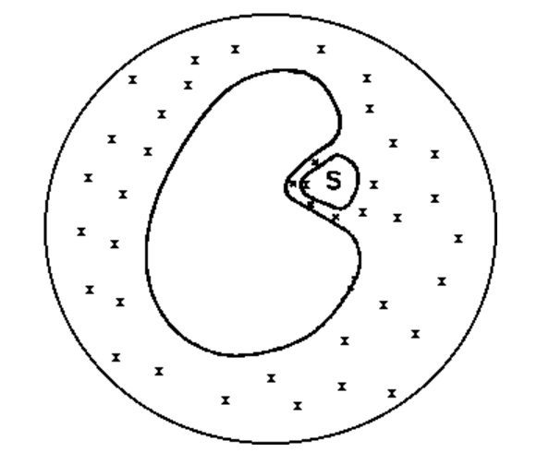
Method 2: Solvation Shell (“droplet”)
Sphere of surrounding waters added to macromolecule
Boundary potential (BP) restrains waters
Trade-off: BP too small → waters ”evaporate”
.. .. large → extraneous forces

Slide 12
C. MD Algorithms
Begin with Newton’s equations of motion (1-D):
$F=ma$ $F=−\frac{dV}{dx}$
Integrate to solve for $x\left(t\right)$ and $v\left(t\right)$:
$$v=at+v_{0}$$
$$x=vt+x_{0}$$
Discretize to create computer algorithm (Leap-Frog):
$$x\left(t+δt\right)=x\left(t\right)+v\left(t+\frac{1}{2}δt\right)δt$$
$$v\left(t+\frac{1}{2}δt\right)=v\left(t−\frac{1}{2}δt\right)+a(t)δt$$

Slide 13
Principles of MD
MD Program Structure
System Preparation
Running MD
Analyzing Results

Slide 14
Essential MD data structures
Parameter file
Contains the force field: all bond, angle parameters etc.
Topology file
Contains data for essential moieties (amino acid residues, DNA bases, small molecules etc.): what is bonded to what, partial atomic charges etc.
PSF
Contains data for ENTIRE SYSTEM (amino acid residue or nucleotide sequence, solvent molecules; list of all bond, angle terms etc.)
Coordinate file
Contains x,y,z coordinates of all atoms in system

Slide 15
MD structure hierarchy for physical system
PSF
Segment 1
Segment 2
Segment 3
Residue 1
Residue 2
Residue 3
Residue 1
Residue 2
Residue 1
Residue 2
Residue 3
Residue 4

Slide 16
MD anachronisms
PSF originally stood for Protein Structure File (the early development of MD codes focused on proteins).
But now used to describe any complete physical system.
Residue originally indicated amino acid residue.
But now refers more generally to substructures from which segments are made.
Nucleotide in DNA
Individual lipid molecule in lipid bilayer
Individual water in set of solvating waters

Slide 17
Principles of MD
MD Program Structure
System Preparation
Running MD
Analyzing Results

Slide 18
Structure of macromolecule
X-ray crystallography
Have to build some missing atoms, including almost all hydrogens
Neutron diffraction
Expensive (uses synchrotron radiation) but resolves the hydrogens
Homology modeling

Slide 19
May need to complete or fix structure: Go through check list
Add missing hydrogens (most not resolved in X-ray diffraction)
Add missing heavy atoms (occasionally not resolved)
Choose between duplicate sets of atoms (crystal structure disorder)
Adjust protonation states for pH being simulated

Slide 20
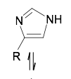
Adjust location of proton to create correct hydrogen bonding patterns
Where isoelectronic groups create experimental ambiguity, adjust for hydrogen bonding (affects His, Asn, Gln: 180º rotation may be needed)

Slide 21
Finish preparing system
Solvate (add waters)
Make neutral (add counter-ions)
Adjust ionic strength? (more counter-ions)

Slide 22
Summary of preparation steps
Create data structure
Read topology file → Parameter file → Sequence
Create coordinates
Read coordinates from pdb file (X-ray)
Build hydrogen coordinates → Add coordinates of other missing atoms
Check structure
Hydrogen bond patterns correct?
Ambiguity due to isoelectronic groups (His, Asn, Gln)?
Generate PSF → Patch to create disulfide bonds etc.
Solvate & Neutralize
Add waters (PSF segment, coordinates)
Add counter-ions to neutralize & adjust ionic strength
Protonation states consistent with pH?
Choose solvation method (periodic boundary conditions or “droplet”)

Slide 23
Principles of MD
MD Program Structure
System Preparation
Running MD
Analyzing Results

Slide 24
FLOWCHART OF AN MD SIMULATION
Initial Coordinates
Minimize Structure
Initialize
Assign Initial Velocities
Heating Dynamics
Equilibration Dynamics
Equilibration
Phase
No
Rescale Velocities
Stable?
Yes
Production Dynamics
Production
Phase
Analysis of Trajectories
Analysis

Slide 25
Judging stability during equilibration
Temperature steady or drifting?
Energy fluctuations small (relative fluctuations < 10⁻⁴)?
RMSD of coordinates steady or drifting?

Slide 26
Principles of MD
MD Program Structure
System Preparation
Running MD
Analyzing Results

Slide 27
Analysis
Whatever you want!
Equilibrium structure
Sampling of hydrogen bonding patterns
Loop conformations
Stability of secondary structure
Opening or closing of channels
Migration of small ligands
…

